Slide 1
British Airways Web Scraping to gain company insights
By: Nicole Huang 7/31/2023

Slide 2
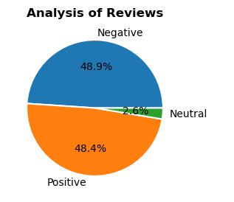
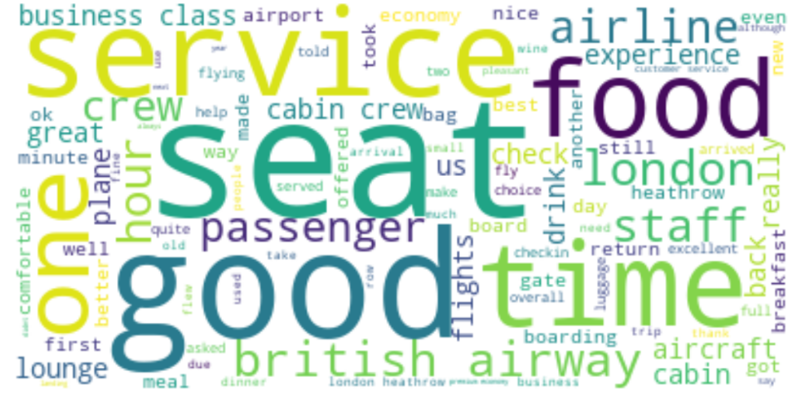
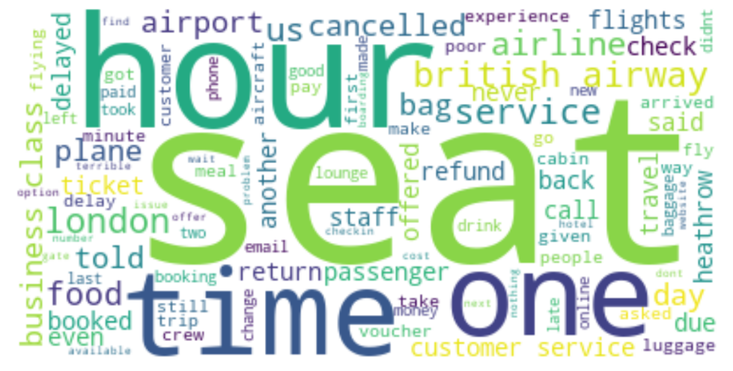
Insights from Customer Reviews
Positive wordcloud
Negative Wordcloud
Most of the positive reviews were about the service and food.
Most of the negative reviews were about the seats and delays of the flights.
Using 100 pages or reviews, we got
Negative – 489
Positive – 484
Neutral - 26

